Slide 1
NBA Scoring Models
Francesco Maria Trasforini - Student ID 887156

Slide 2
Problem Statement
The goal of the project is to develop different models to predict the points scored by NBA players
The predicted value is the amount of points scored per game
The prediction is based on some player statistics (features)
It is a regression problem

Slide 3
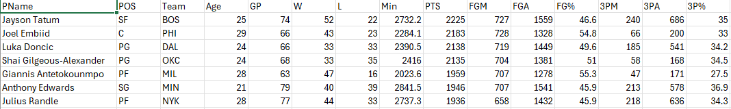
Dataset Overview
Source: NBA player stats for the 2023 season
540 players
29 features + 1 target feature
e.g. Assists, Rebounds, Blocks, Field Goal%, 3P%...
Target: Average points scored

Slide 4
Data Preprocessing
Check for missing values
Outliers handling: I choose to drop all players that played less than 200 minutes
First, I choose to normalize the data per game, since the dataset contained mostly season totals
I run a correlation analysis on the features: in particular I was interested in finding features with high correlation with points scoring
I dropped the features that had correlation over 0.8 with points scoring
I used a Standard Scaler to standardize the data

Slide 5
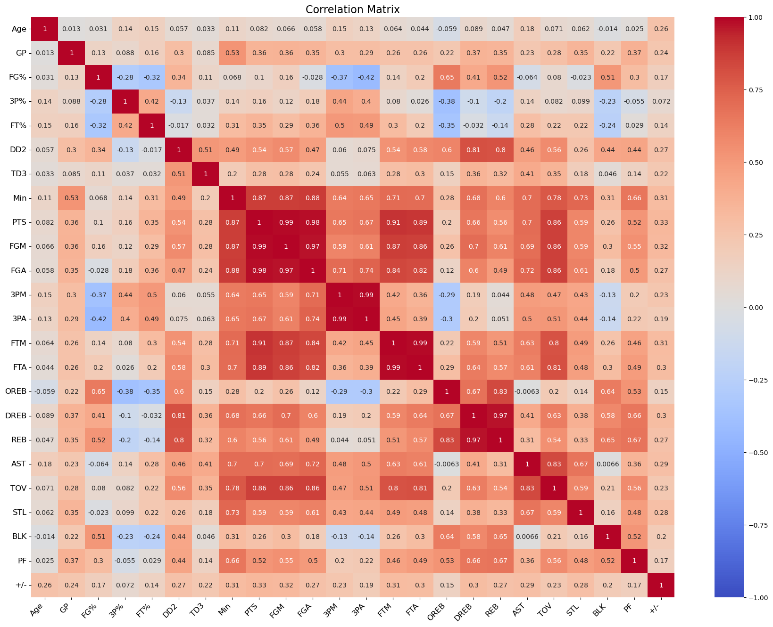

Slide 6
Model Selection
Developed models:
Linear Regression
knn
SVM
MLP (Neural Network Regressor)
Reasoning: Compare different model types

Slide 7
Hyperparameter Tuning
Method: Grid Search
knn parameters: number of neighbors (all even numbers from 3 to 15), weights (uniform or distance), metric (Euclidean, Manhattan, Minkowski)
SVM parameters: kernel (linear, rbf, poly), C (a regularization parameter controlling the generalization ability of the model), gamma (scale or auto), degree (only relevant for “poly” kernel)
MLP parameters: hidden layer sizes (including number of hidden layers), activation function (tanh, relu, logistic), solver (adam, sgd, lbfgs), alpha, learning rate

Slide 8
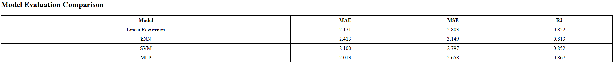
Model Evaluation
Metrics: MAE, MSE, R-squared
MLP has slightly better performance than any other model by any metric taken in consideration

Slide 9
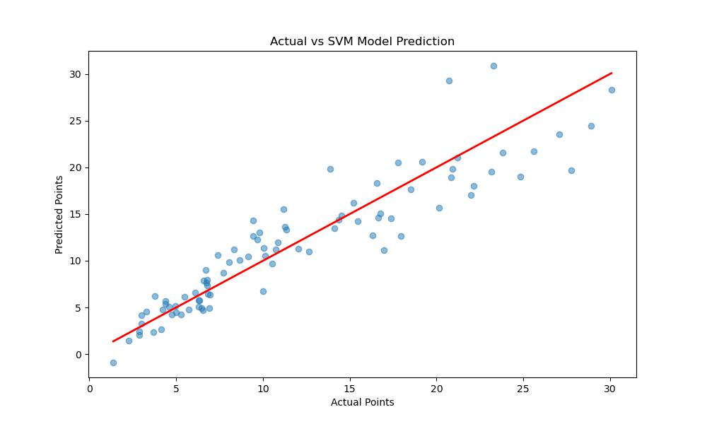
Example plot of results
(More on the Web App)

Slide 10
Web application
Flask App
Flow:
input the statistics of a player
Select a model
get the points prediction
In addition, on the app it is possible to see:
model evaluation plots
model evaluation comparison
model predictions comparison
feature importance comparison

Slide 11
Conclusion
All models perform well, with mlp edging the others out by a small margin
On the other hand, mlp training time is by far the longest

